Slide 1

Credit Card Churn Analysis & Prediction
Understanding and Predicting Customer Churn

Slide 2
Team names
Zeyad Ahmed Mostafa
Mahmoud Saad Mahmoud
Ahmed Mohamed Tawfiq
Mohamed Badr Mohamed
Alaa Ghalib Osman (Military service)

Slide 3

Introduction
In today's competitive business landscape, predicting customer churn is crucial for maintaining a loyal client base and driving growth. By identifying customers at risk of leaving, businesses can implement proactive strategies to retain them. This project leverages machine learning techniques to develop predictive models that classify the likelihood of customer churn based on demographic, transactional, and engagement data.
Focusing on the highly competitive banking sector, this presentation provides an in-depth analysis of credit card churn using a comprehensive dataset from Kaggle, offering insights into customer behavior and retention strategies.

Slide 4

Customer Churn in Banking
1
Importance of Churn Prediction
2
Key Factors Influencing Churn
Customer churn can have a significant impact on a bank's revenue and profitability. Accurately predicting churn allows banks to proactively retain valuable customers.
Factors like customer age, income, relationship duration, and card usage patterns can all contribute to a customer's likelihood of churning.
3
Competitive Landscape
In the highly competitive banking sector, retaining customers is essential for maintaining market share and profitability.

Slide 5

Proposed Methodology
Data Collection and Exploration
Machine Learning Model Development
Thoroughly examine the dataset to understand the distributions, patterns, and relationships between the variables.
Train and optimize a machine learning model, such as a decision tree or logistic regression, to predict customer churn probability.
1
2
3
4
Data Analysis and Visualization
MLOps, Deployment, and Final Presentation
examining datasets to uncover patterns, trends, and insights, and then presenting these findings in a visual format to make them easily
making a machine learning model available for use in a production environment. This can be done through various methods:

Slide 6

1-Data Collection and Exploration

Slide 7
Dataset Overview
Source
Size
Key Features
The dataset includes variables such:-
The dataset was obtained from Kaggle, a popular platform for sharing and exploring public datasets.
The dataset contains 10,127 rows and 23 features, providing a comprehensive view of customer behavior and churn patterns.
CLIENTNUM
Attrition_Flag
Customer_Age
Gender Dependent_count
Education_Level
Marital_Status Income_Category
Card_Category Months_on_book Total_Relationship_Count Months_Inactive_12_mon Contacts_Count_12_mon
Credit_Limit Total_Revolving_Bal
Avg_Open_To_Buy Total_Amt_Chng_Q4_Q1 Total_Trans_Amt Total_Trans_Ct Total_Ct_Chng_Q4_Q1 Avg_Utilization_Ratio
Link of dataset : https://www.kaggle.com/datasets/anwarsan/credit-card-bank-churn

Slide 8
Key Features Description

Slide 9
Key Feature
Description
Data type
CLIENTNUM
Unique identifier for each customer
int64
Attrition_Flag
Indicates whether a customer has churned or is still active
object
Customer_Age
Age of the customer
int64
Total_Trans_Amt
Total transaction amount for the customer
float64
Gender
Gender of the customer
object
Dependent_count
Number of dependents the customer has
int64
Education_Level
Educational attainment of the customer
object
Marital_Status
Marital status of the customer
object
Income_Category
Income bracket of the customer
object
Card_Category
Type of credit card held by the customer
object
Months_on_book
Number of months the customer has been with the bank
int64
Total_Relationship_Count
Number of products the customer has with the bank
int64
Months_Inactive_12_mon
Number of months the customer was inactive in the past 12 months
int64
Contacts_Count_12_mon
Number of contacts the customer had with the bank in the past 12 months
int64
Credit_Limit
Credit limit on the customer's credit card
float64
Total_Revolving_Bal
Total revolving balance on the customer's credit card
float64
Avg_Open_To_Buy
Average amount of credit available to the customer
float64
Total_Amt_Chng_Q4_Q1
Change in total transaction amount from Q1 to Q4
float64
Total_Trans_Ct
Total number of transactions for the customer
int64
Total_Ct_Chng_Q4_Q1
Change in total number of transactions from Q1 to Q4
float64
Avg_Utilization_Ratio
Average utilization ratio of the customer's credit card
float64

Slide 10
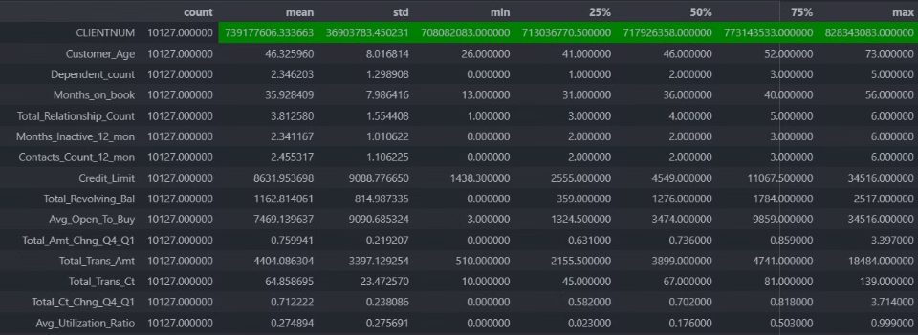
Descriptive Statistics for Numerical Variables
The descriptive statistics for the numerical variables in the dataset provide valuable insights. The code below highlights the maximum values in the dataset, which can help identify outliers and extreme cases that may require further investigation.
data.describe(include='number').T.style.highlight_max(subset=['mean' ,'std' ,'min' ,'25%' ,'50%' ,'75%' ,'max'],color='green')

Slide 11
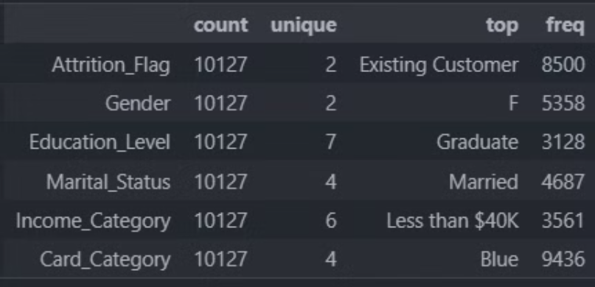
Descriptive Statistics for Categorical Features
To gain a deeper understanding of the categorical features in the dataset, we analyzed their descriptive statistics using the following code:
data.describe(exclude='number').T
This provided insights into the distribution and frequency of the different categories within each feature, helping to identify any potential biases or imbalances in the data.

Slide 12

2 - Data Analysis and Visualization(EDA)

Slide 13

Data Validation & drop unnecessary columns
Drop Unnecessary Columns
Removed unnecessary columns to focus the analysis on the most relevant features.
Validate Data Types
data.drop(columns=['CLIENTNUM'],inplace=True)
Ensured all columns have the appropriate data types for accurate analysis and modeling.
separate the columns of a DataFrame into categorical and numerical columns:
data[cat_columns] = data[cat_columns].astype('category')
cat_columns = list(data.select_dtypes(exclude=['number']).columns)
numerical_columns = list(data.select_dtypes(include='number'))

Slide 14


Independent Feature Analysis
(Categorical Feature )
Categorical Feature Breakdown
Identifying Key Drivers
Analyzed the number of unique categories in each categorical feature, ranging from 2 categories (e.g. Attrition_Flag, Gender) to 7 categories (e.g. Education_Level).
Examined the distribution and frequency of categories within each feature to uncover potential relationships and identify the most influential variables in predicting customer churn.
for n,i in enumerate(cat_columns , start=1) :
print(f'{n}-The number of Categories in "{i}" is {data[i].nunique()} and The Categries is > {data[i].unique()}\n ')

Slide 15
Exploratory Data Analysis: Categorical Feature
Attrition_Flag
Gender
Education_Level
Existing
Male
Graduate
High School
Attrited
Female
Uneducated
College
Post-Graduate
Doctorate
Unknown
Marital_Status
Income_Category
Card Category
Married,
Less than $40K,
Blue,
$40K - $60K,
Single,
$60K - $80K,
$80K - $100K,
Gold,
Unknown,
Platinum,
Divorced
$100K - $120K,
$120K+
Silver

Slide 16
Customizing Value Counts
The provided function enhances the standard value_counts() method by providing additional insights beyond just the count of each category. It calculates the percentage of each category and presents the results in a more formatted DataFrame.
def value_counts(data, column):
value_counts = data[column].value_counts(normalize=True, dropna=False) * 100
formatted_data = pd.DataFrame({
'Count': data[column].value_counts(dropna=False),
'Percentage (%)': value_counts.round(2)
}).reset_index()
formatted_data.columns = [column.capitalize(), 'Count', 'Percentage (%)']
return formatted_data

Slide 17
Customizing calculator attrition rates
The provided function enhances the standard value_counts() method by providing additional insThis Python function, calculate_attrition_rates, is designed to analyze customer attrition rates based on a specified categorical column in a pandas DataFrame.
def calculate_attrition_rates(df, column):
# Create a crosstab to count attrited and existing customers by the specified column
crosstab = pd.crosstab(df[column], df['Attrition_Flag'])
# Add total counts for each category
crosstab['Total'] = crosstab.sum(axis=1)
# Calculate attrition rate and existing customer rate
crosstab['Attrition Rate (%)'] = (crosstab['Attrited Customer'] / crosstab['Total']) * 100
crosstab['Existing Customer Rate (%)'] = (crosstab['Existing Customer'] / crosstab['Total']) * 100
# Reset index to turn the index into a column
crosstab.reset_index(inplace=True)
return crosstab.style.highlight_max(subset=['Attrition Rate (%)'],color='#ff6e76')
# Example usage with your DataFrame (assuming it's named 'data')
attrition_results = calculate_attrition_rates(data, 'Card_Category')

Slide 18
Categorical Feature Analysis
This code iterates over each categorical column, displaying value counts and their distribution by the target variable, `Attrition_Flag` attrition rates
for col in cat_columns:
print(f'The {col} Value counts')
display(value_counts(data , col))
print(f'The {col} Value counts by Target(Attrition_Flag)')
display(calculate_attrition_rates(data,col))

Slide 19
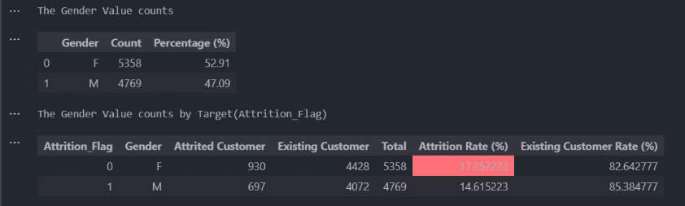
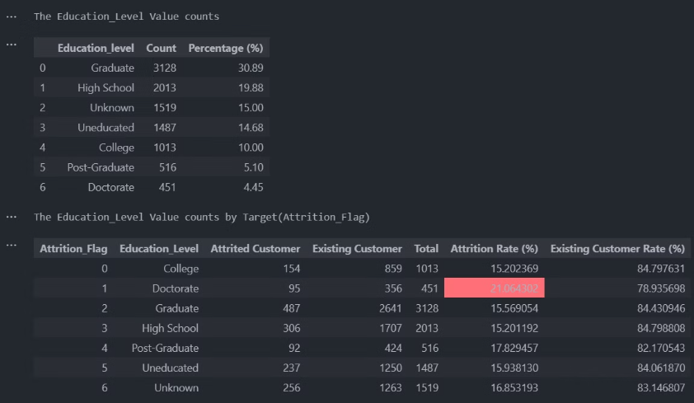
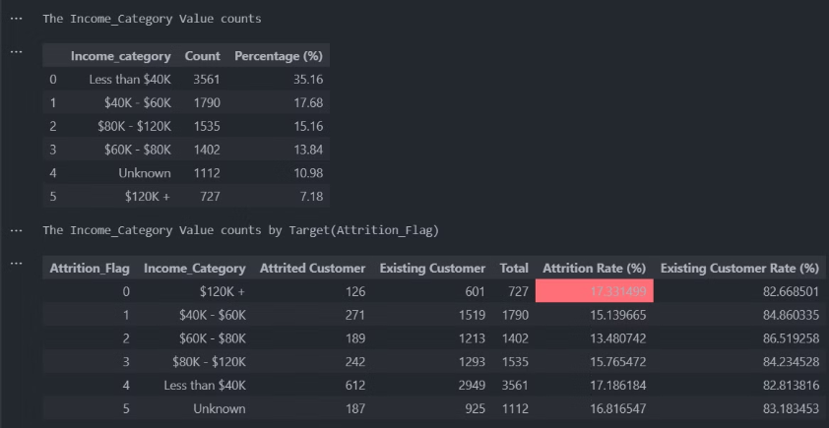
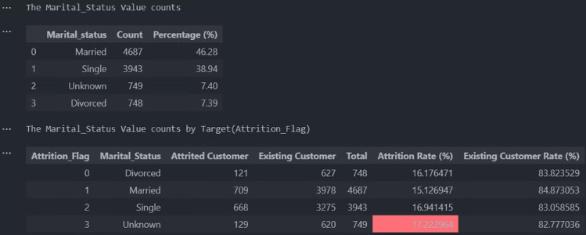
Output

Slide 20
Overview of Value Counts
Attrition Flag
Gender
Education Level
Most customers are Existing (83.93%), while Attrited customers make up 16.07% of the total.
The customer base is evenly split, with Females making up 52.91% and Males 47.09%.
The largest groups are Graduate (30.89%), High School (19.88%), and Unknown (15.00%) education levels.
Marital Status
Income Category
Card Category
Most customers are Married (46.28%) or Single (38.94%), with smaller percentages of Divorced (7.39%) and Unknown (7.40%) statuses.
The largest income group is Less than $40K (35.16%), followed by $40K - $60K (17.68%) and $80K - $120K (15.16%).
The vast majority of customers hold a Blue card (93.18%), with smaller percentages of Silver (5.48%), Gold (1.15%), and Platinum (0.20%) cards.

Slide 21





Key Insights from Attrition Analysis:
Gender
Female customers have a higher attrition rate (17.36%) compared to males (14.62%).
Education Level
Customers with a Doctorate show the highest attrition rate (21.06%), indicating a higher risk among highly educated individuals.
Marital Status by Churn
Single (16.94%) and Unknown (17.22%) marital status customers are more likely to leave.
Card Category
Platinum cardholders have the highest attrition rate (25%), followed by Gold (18.10%).
Income Category
Highest attrition among both the high-income group ($120K+, 17.33%) and the low-income group (Less than $40K, 17.19%).

Slide 22
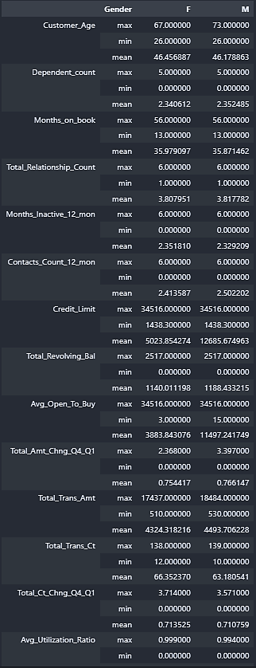
Gender-Based Numerical Features Analysis
data.groupby('Gender')[numerical_columns].agg(['max' , 'min' , 'mean',]).T
This analysis highlights that while most behaviors are similar between genders, there are notable differences in credit limit, available credit, and credit utilization patterns.

Slide 23
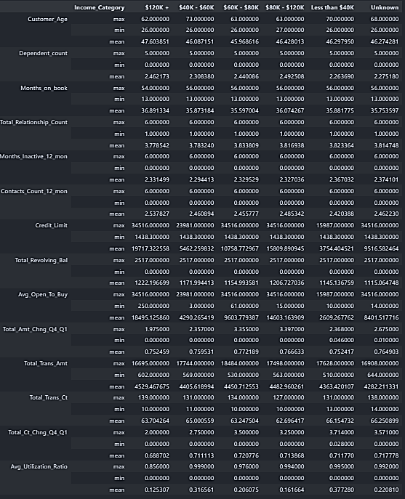
Income_Category-Based Numerical Features Analysis
data.groupby('Income_Category')[numerical_columns].agg(['max' , 'min' , 'mean',]).T
Targeted Credit Limit Management
Key Insight: The credit limits vary significantly across income categories. Higher income groups (e.g., $120K+) have an average credit limit of $19,717, while lower income groups like those earning Less than $40K have much lower credit limits ($3,754).
Actionable Strategy: You can enhance customer satisfaction and loyalty by offering personalized credit limits based on spending habits, not just income. Customers in lower income categories might appreciate higher limits if they demonstrate good credit behavior, improving retention. Optimized Utilization of Revolving Balance
Key Insight: The Average Utilization Ratio is much higher for lower income categories (e.g., 0.38 for Less than $40K) compared to higher income groups (0.12 for $120K+). This suggests lower-income customers rely more on their revolving credit balances.
Actionable Strategy: Implement a reward program or financial coaching aimed at helping lower-income customers manage their credit utilization better. This could reduce credit risk and foster trust, while also encouraging higher card usage in a controlled way, benefiting both the customer and the business.

Slide 24
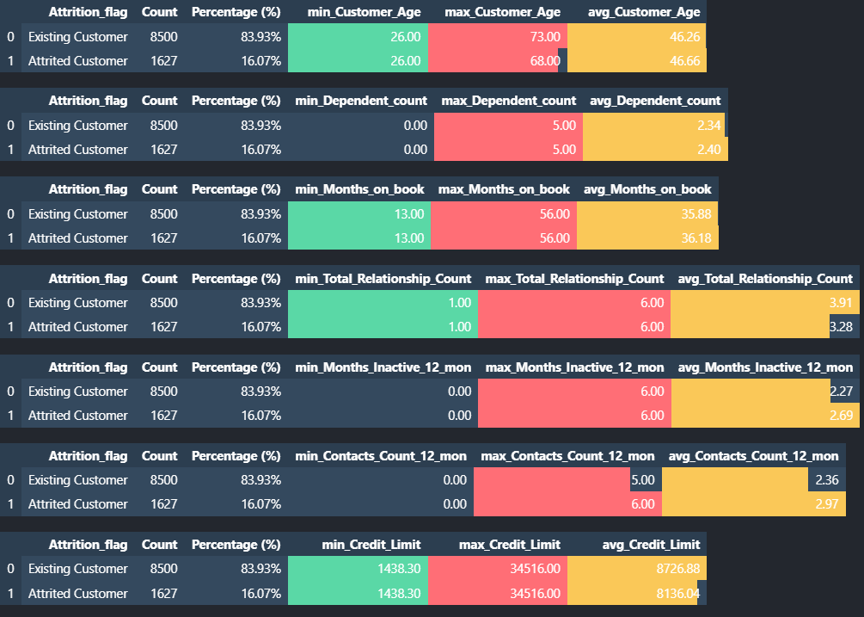
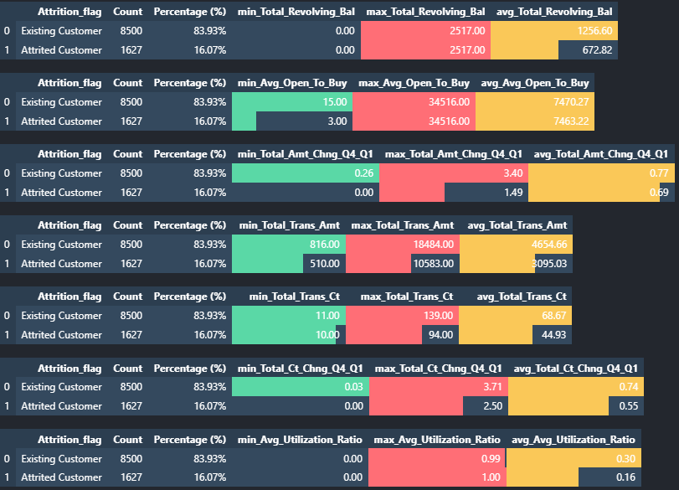
for col in numerical_columns:
display(add_custom_stats(data,value_countsd,'Attrition_Flag',[col]))

Slide 25
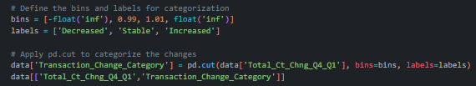
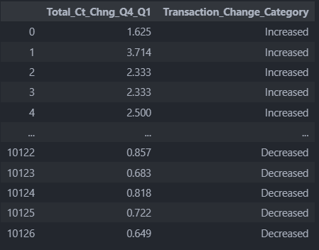
Feature Engineering
This code snippet converts the Total_Ct_Chng_Q4_Q1 column into a categorical feature named Transaction_Change_Category

Slide 26
Data Visualization
distribution of numerical columns
This code creates a series of histograms to visualize the distribution of numerical columns in a dataset, with an overlay of churn information (Attrition_Flag).
fig, axes = plt.subplots(14, 1, figsize=(10, 35))
# Plot histograms for each numerical column
for i, col in enumerate(numerical_columns):
sns.histplot(data=data, x=col, ax=axes[i], kde=True, hue='Attrition_Flag', palette=['red', 'blue'])
axes[i].set_title(f'Histogram of {col}')
# Add the suptitle
fig.suptitle('Distribution of Numerical Columns with Churn Information', fontsize=16)
# Adjust layout to make space for the suptitle
plt.tight_layout(rect=[0, 0, 1, 0.97])
# Show the plot
plt.show()

Slide 27
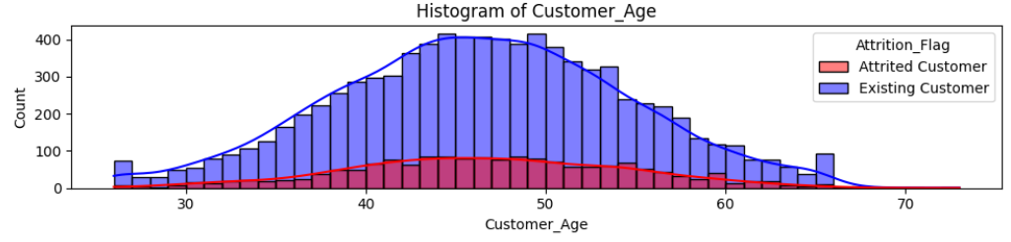
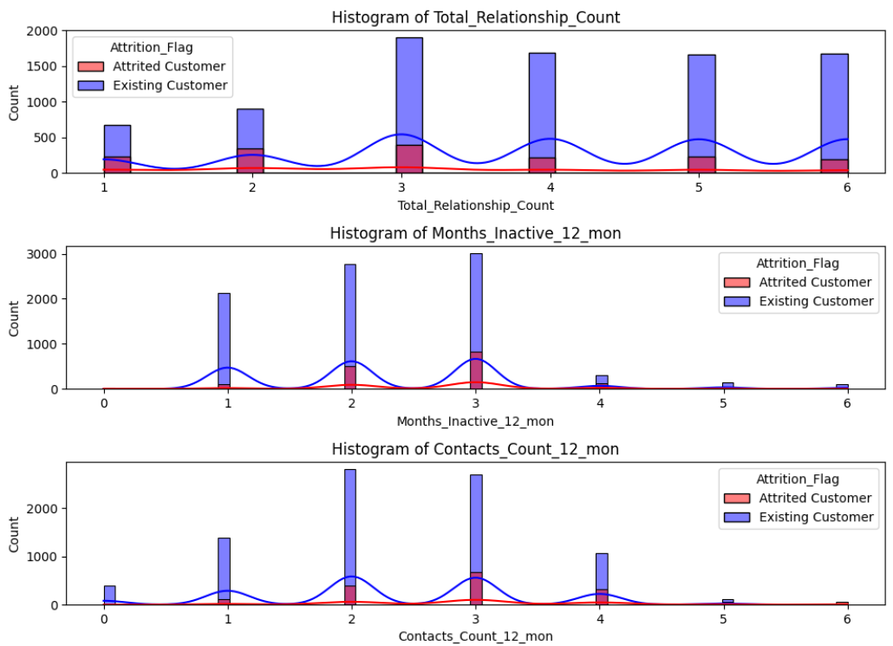
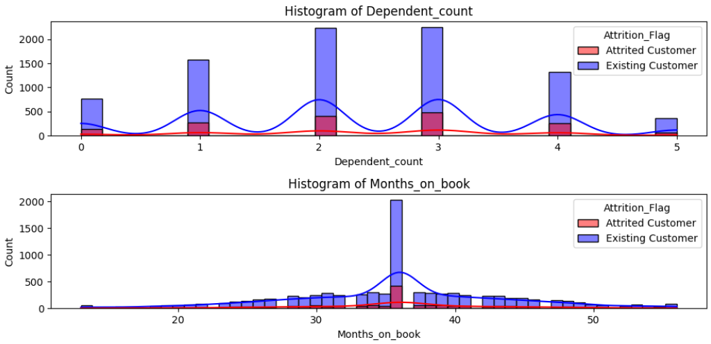
distribution of numerical columns with churn information

Slide 28
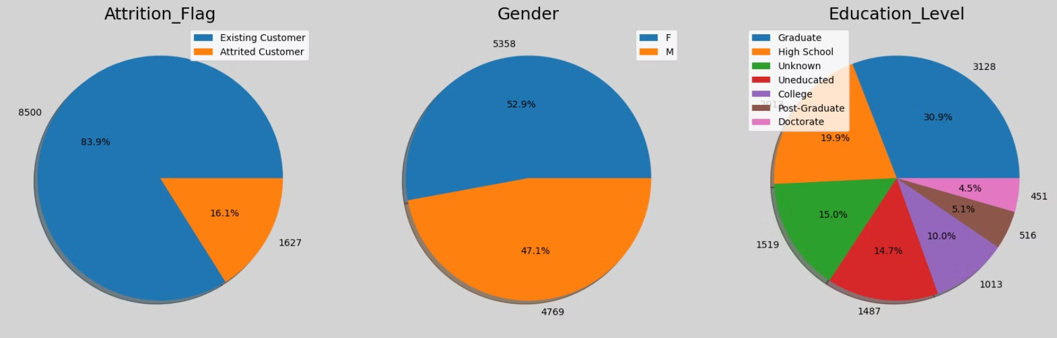
distribution of Categorical data
This code creates pie charts to visualize the distribution of the first three categorical columns then the second Three in the dataset.
ig, axes = plt.subplots(1, 3, figsize=(20, 12), facecolor="lightgray")
for i, column in enumerate(cat_columns[:3]):
ax = axes[i]
d = data[column].value_counts()
ax.pie(d, labels=d.values,autopct="%1.1f%%",shadow=True)
ax.set_title(column,size=18)
ax.legend(d.index)

Slide 29
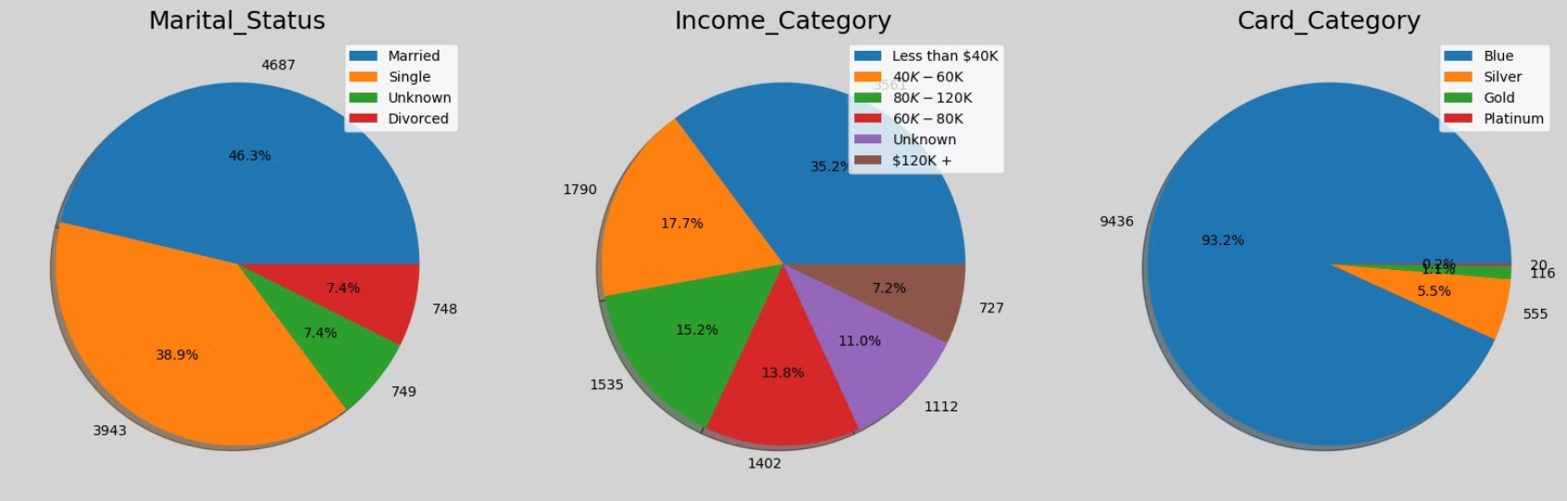
distribution of Categorical data
This code creates pie charts to visualize the distribution of the first three categorical columns then the second Three in the dataset.
ig, axes = plt.subplots(1, 3, figsize=(20, 12), facecolor="lightgray")
for i, column in enumerate(cat_columns[3:]):
ax = axes[i]
d = data[column].value_counts()
ax.pie(d, labels=d.values,autopct="%1.1f%%",shadow=True)
ax.set_title(column,size=18)
ax.legend(d.index)

Slide 30
Numerical Features by Churn Status
This code creates bar plots to compare the mean values of numerical features by churn status
fig, axes = plt.subplots(14, 1, figsize=(8, 44))
important_columns = [
'Credit_Limit',
'Total_Revolving_Bal',
'Avg_Open_To_Buy',
'Total_Trans_Amt',
'Total_Trans_Ct',
'Months_on_book'
]
for i, col in enumerate(numerical_columns):
sns.barplot(data=data, x='Attrition_Flag', y=col, ax=axes[i], palette='GnBu')
axes[i].set_title(f'Mean of {col} by Churn', fontsize=12)
fig.suptitle('Comparison of Numerical Features by Churn Status', fontsize=16 , y =1)
plt.tight_layout()
plt.show()

Slide 31
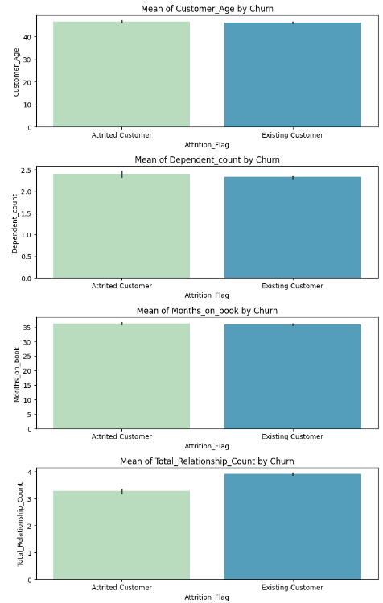
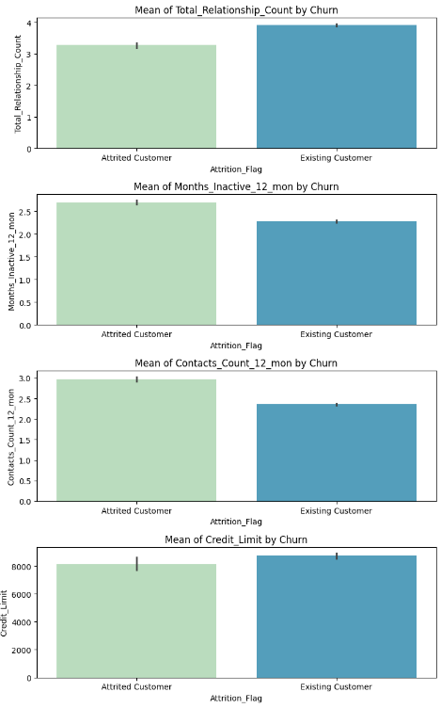
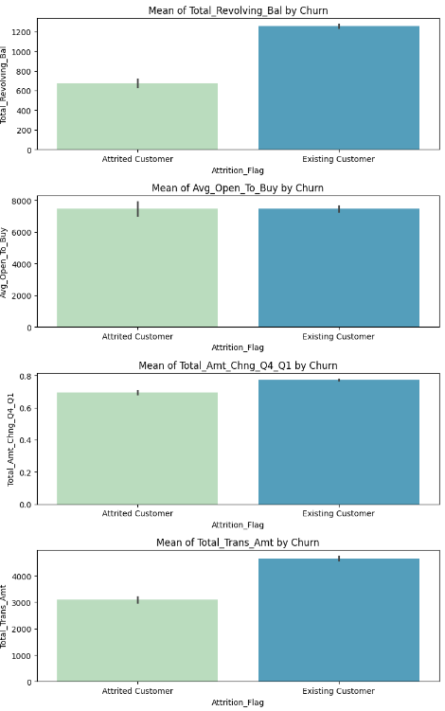
Comparison of Numerical Features by Churn Status
Machine Learning Model Development

Slide 32
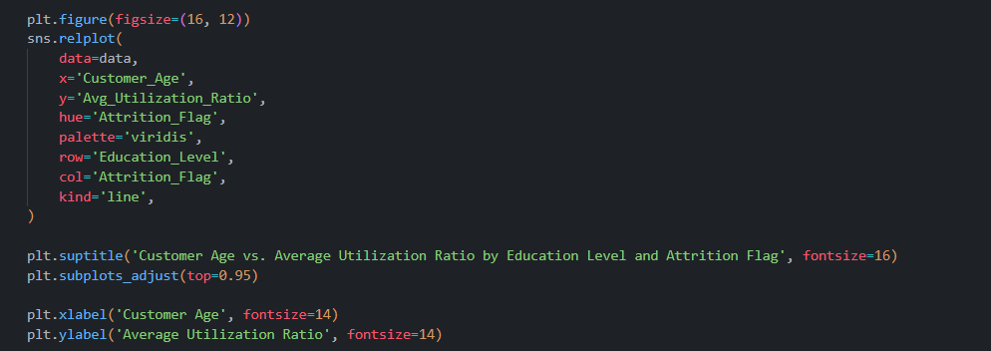
Customer Age vs. Average Utilization Ratio
(Line plot)

Slide 33
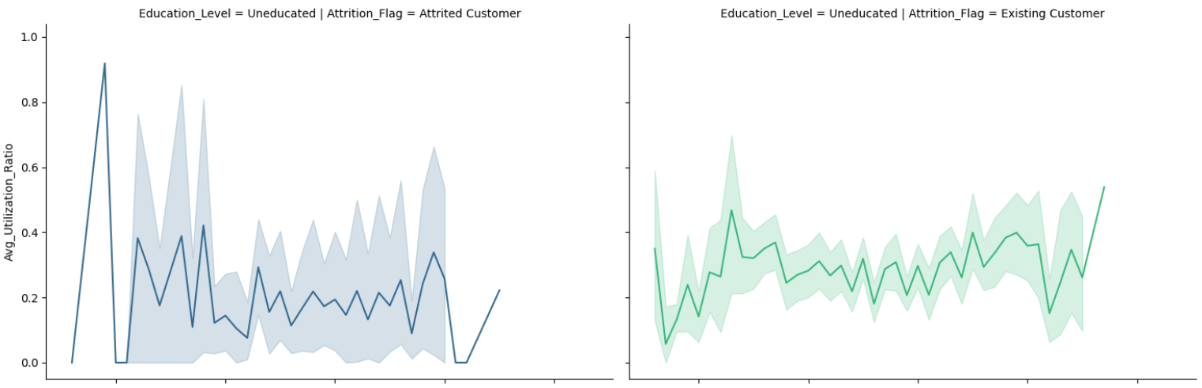
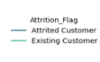
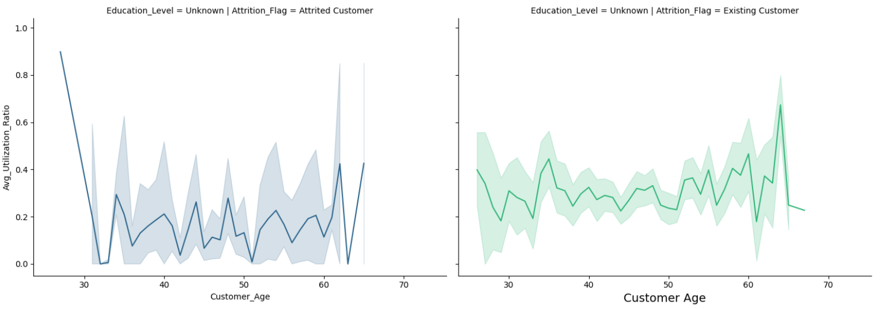

Slide 34
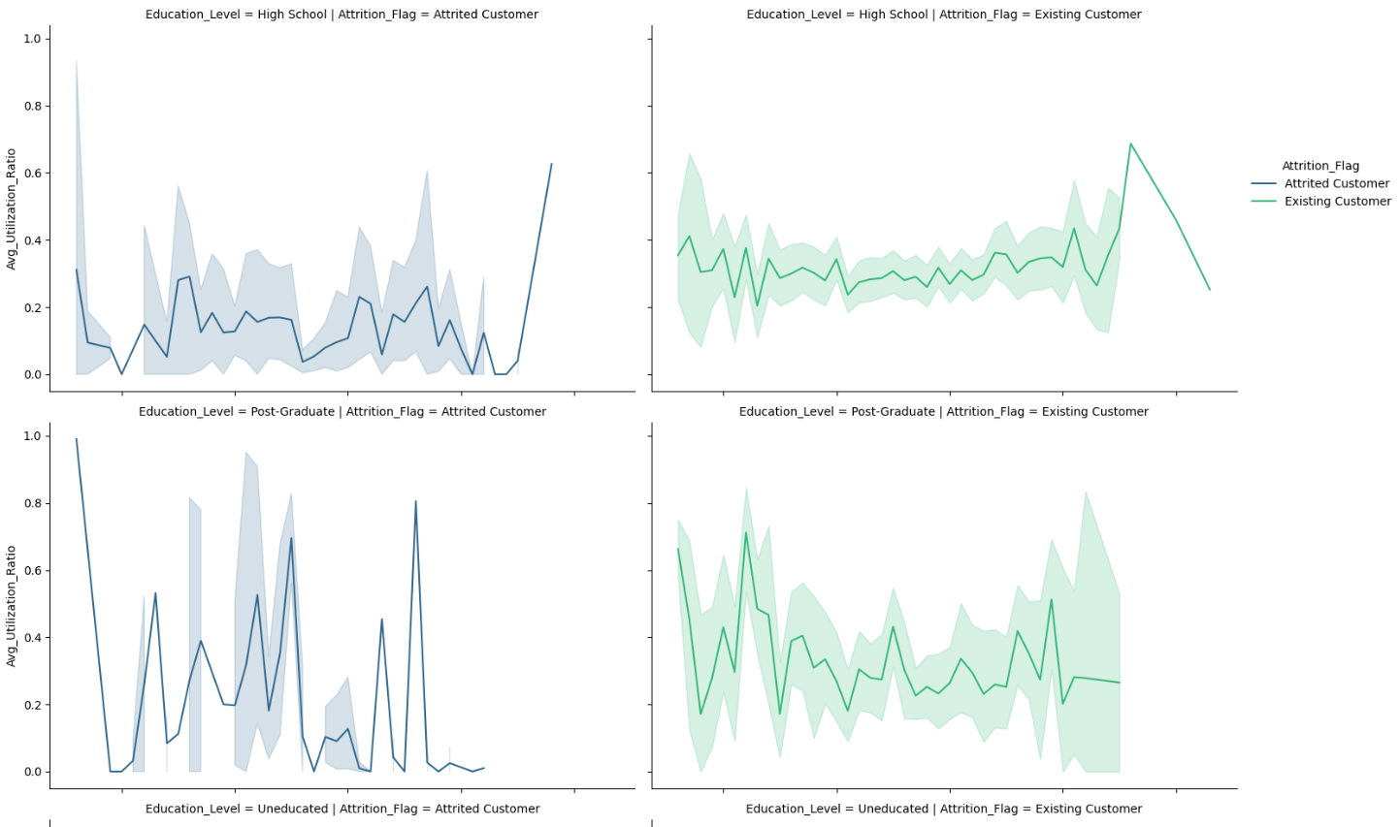

Slide 35
3-Machine Learning Model Development

Slide 36
Data Preprocessing
Our data preprocessing involved several crucial steps. We began with feature selection, dropping uninformative features. The target variable, Attrition_Flag, was mapped to numeric values (0 for No Attrition, 1 for Attrition). Categorical data was handled through label encoding, converting features like Gender and Education_Level to numerical format.
To address class imbalance, we applied SMOTE, generating synthetic samples for the minority class. Finally, we performed feature scaling using StandardScaler, crucial for algorithms sensitive to data scale.
Feature Selection
1
Dropped uninformative features with low variance or many missing values.
2
Target Variable Mapping
Mapped Attrition_Flag to 0 (No Attrition) and 1 (Attrition).
Categorical Data Handling
3
Used label encoding for categorical features.
4
Class Imbalance
Applied SMOTE to generate synthetic samples for minority class.
Feature Scaling
5
Used StandardScaler to standardize numerical features.

Slide 37
Models Trained
We trained a diverse set of machine learning algorithms to predict customer attrition. Our selection included both simple and complex models to ensure a comprehensive evaluation. The algorithms ranged from traditional methods like Logistic Regression and Naive Bayes to more advanced ensemble techniques such as Random Forest, AdaBoost, and Gradient Boosting variants.
Traditional Models
Ensemble Methods
Evaluation Metrics
Logistic Regression
Random Forest
Accuracy
Naive Bayes
AdaBoost
Precision
K-Nearest Neighbors
Gradient Boosting
Recall
Decision Tree
XGBoost
F1-Score
LightGBM

Slide 38
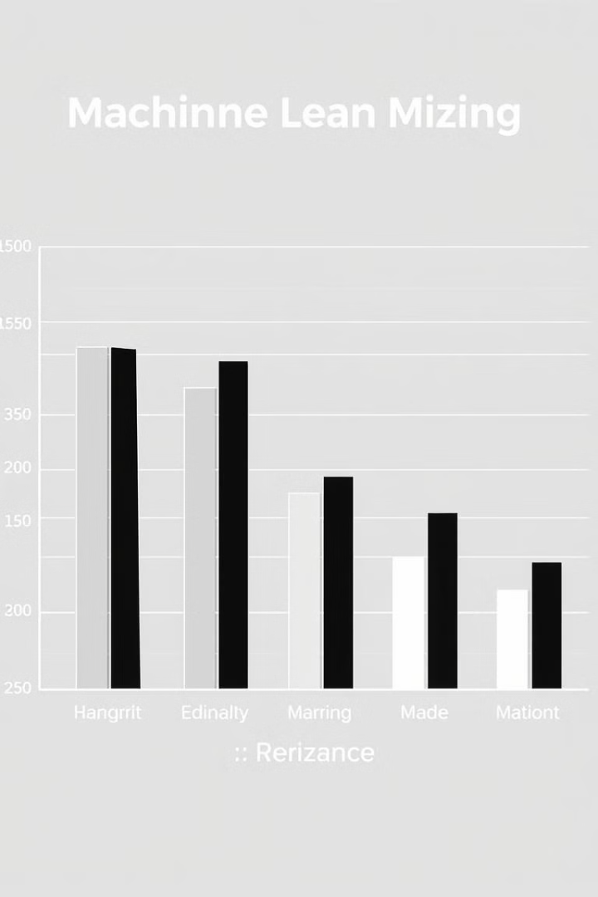
Performance Summary
Our performance summary provides a comprehensive overview of how each model performed in predicting customer attrition. The table below showcases the key metrics for each algorithm, including accuracy, precision, recall, and F1-score for Class 1 (Attrition).
Model
Accuracy
Precision (Class 1)
Recall (Class 1)
F1-Score (Class 1)
Logistic Regression
0.84
0.50
0.77
0.61
Naive Bayes
0.77
0.39
0.70
0.50
K-Nearest Neighbors
0.84
0.50
0.78
0.61
Decision Tree
0.93
0.74
0.87
0.80
Random Forest
0.94
0.77
0.90
0.83
AdaBoost
0.26
0.18
1.00
0.30
Gradient Boosting
0.95
0.79
0.93
0.86
XGBoost
0.95
0.79
0.91
0.85
LightGBM
0.95
0.79
0.92
0.85

Slide 39
Best Performing Model: Gradient Boosting
Gradient Boosting emerged as our top-performing model with impressive metrics: 0.95 accuracy, 0.79 precision, 0.93 recall, and 0.86 F1-score for Class 1 (Attrition). Its high recall of 0.93 is particularly significant, indicating effective identification of potential attritors.
We chose Gradient Boosting for its overall performance, balancing precision and recall. It's known for robustness against overfitting and can handle complex data relationships. While more complex than some models, it still offers valuable insights into feature importance, aiding in understanding customer behavior and guiding retention strategies.
1
High Recall
2
Overall Performance
0.93 recall effectively identifies a large proportion of actual attritors, crucial for minimizing customer loss.
Excellent accuracy (0.95) and F1-score (0.86) reflect a good balance between precision and recall.
3
Robustness and Flexibility
4
Model Interpretability
Handles complex relationships in data and resists overfitting, especially with proper tuning.
Provides insights into feature importance, valuable for understanding customer behavior.

Slide 40
4-Deployment, and Final Presentation

Slide 41

Deployment Overview
1
Environment
Requires Python with Streamlit, pandas, joblib, and scikit-learn libraries.
2
Key Features
Multiple models and flexible data input options available.

Slide 42

How to Use: Model Selection
Using the Customer Attrition Prediction App is a straightforward process designed for ease of use. The first step involves selecting a machine learning model from the provided dropdown list. This allows users to experiment with different predictive models and compare their effectiveness.
For data input, users have two options. They can manually enter customer attributes into the required fields, which is ideal for individual customer analysis. Alternatively, for bulk predictions, users can upload a prepared CSV file containing customer data. Once the data is input, users simply click the "Predict" button to generate predictions. The output is displayed as an array of Attrition_Flag values, indicating potential customer churn.
Select Model
1
Choose a machine learning model from the dropdown list.
2
Input Data
Enter customer attributes manually or upload a CSV file.
Generate Predictions
3
Click "Predict" to get Attrition_Flag values indicating potential churn.

Slide 43
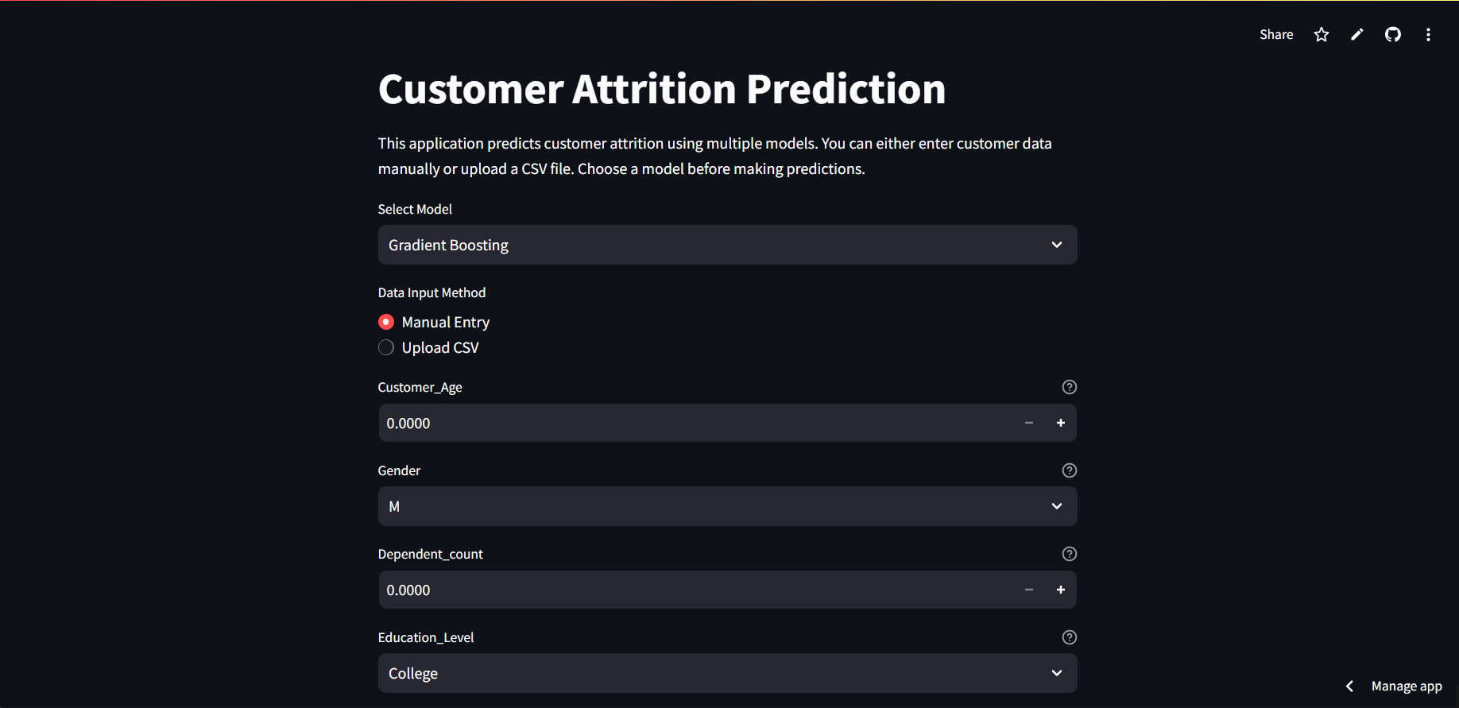
App Interface

Slide 44
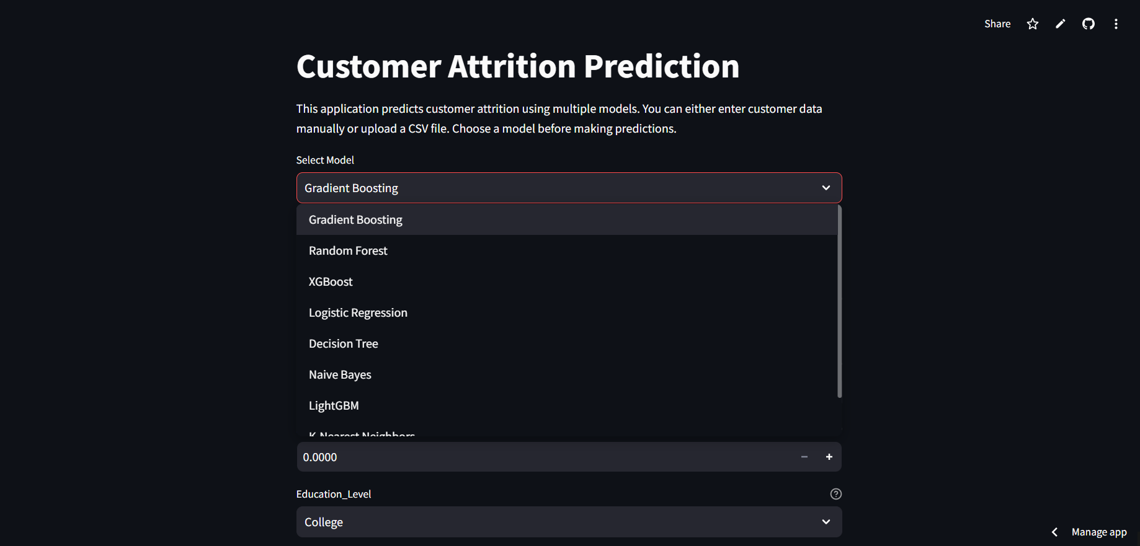
Choosing The Model

Slide 45
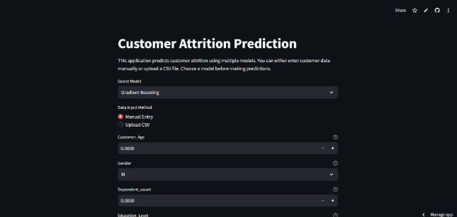
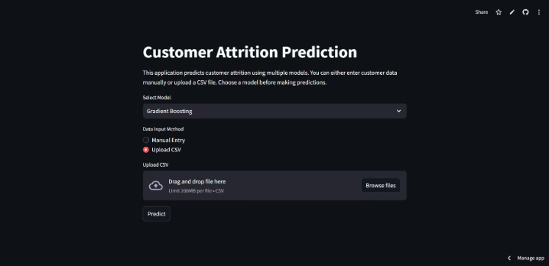
Choose Entering Manually or Upload a CSV file
Entering Manually
Upload a CSV file

Slide 46
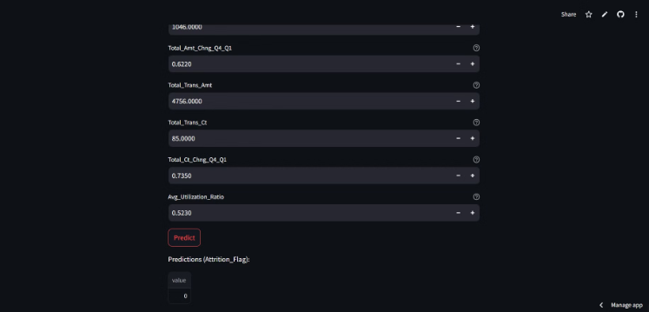
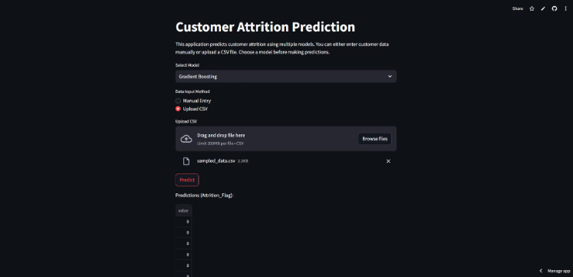
Prediction
Entering Manually
Upload a CSV file

Slide 47
Any Questions ?

Slide 48
Thanks

